Slide 1




$$\hat{y}$$
$$\hat{z}$$
$$\hat{x}$$
$$δ_{x}$$

Slide 2






$$\vec{r}(t) ={\vec{r}}_{0}+\vec{V}t$$
$$\vec{d}={\vec{r}}_{s}\left(t+δt\right)−{\vec{r}}_{s}\left(t\right)=Vδt\hat{x}$$
$$\vec{V}$$
$$\vec{d}$$
$${\vec{r}}^{∗}$$
$$\vec{r}$$

Slide 3



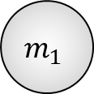



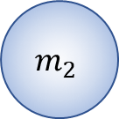










$$m_{1}{\vec{r}}_{1}+m_{2}{\vec{r}}_{2}≡M\vec{R}$$
$${\vec{V}}_{1}$$
$${\vec{V}}_{2}$$
$${\vec{V}}_{1}$$
$$m_{1}{\vec{v}}_{1}+m_{2}{\vec{v}}_{2}={\vec{p}}_{1}+{\vec{p}}_{2}={\vec{p}}_{tot}≡M\vec{U}$$
$$R_{1}$$
$$m_{1}$$
$${\vec{V}}_{2}$$
$${\vec{ρ}}_{1}$$
$$m_{2}$$
$${\vec{ρ}}_{2}$$
$$\vec{r}$$
$${\vec{r}}_{1}$$
$${\vec{r}}_{1}$$
$$\vec{R}$$
$$R_{2}$$
$${\vec{r}}_{2}$$
$${\vec{r}}_{2}$$

Slide 4







$$\vec{V}$$
$$\vec{V}$$
$$\vec{r}$$
$$\vec{r}$$
$$\hat{y}$$
$$\hat{z}$$
$$\hat{x}$$

Slide 5
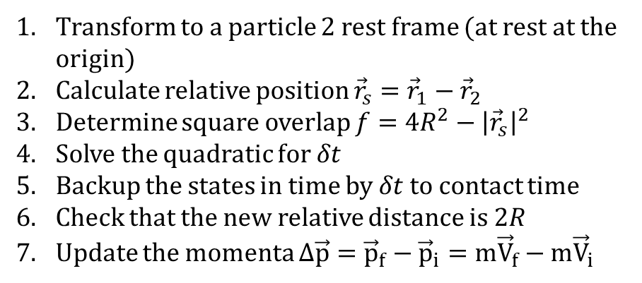







Transform to a particle 2 rest frame (at rest at the origin)
Calculate relative position ${\vec{r}}_{s}={\vec{r}}_{1}−{\vec{r}}_{2}$
Determine square overlap $f=4R^{2}−{\left|{\vec{r}}_{s}\right|}^{2}$
Solve the quadratic for $δt$
Backup the states in time by $δt$ to contact time
Check that the new relative distance is $2R$
Update the momenta $Δ\vec{p}={\vec{p}}_{f}−{\vec{p}}_{i}=m{\vec{V}}_{f}−m{\vec{V}}_{i}$
$${\vec{V}}_{f}$$
$$α$$
$$\vec{V}$$
$$α$$
$$θ$$
$${\vec{V}}_{i}$$
$$\vec{r}$$
$${\vec{r}}^{∗}$$
$$\hat{y}$$
$$\hat{z}$$
$$\hat{x}$$

Slide 6
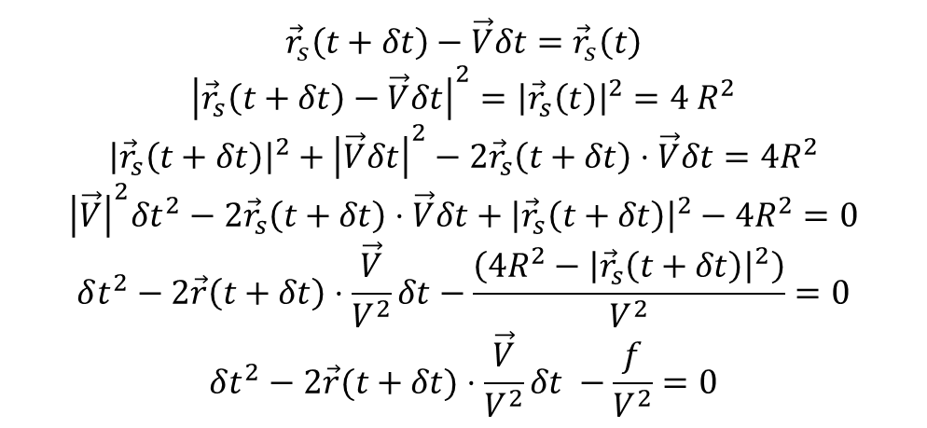






$${\vec{r}}_{s}=b\hat{y}+\left(x_{0}+Vt\right)\hat{x}$$
$${δ\vec{r}}_{s}={\vec{r}}_{s}\left(t+δt\right)−{\vec{r}}_{s}\left(t\right)=Vδt\hat{x}$$
$$b$$
$${\vec{r}}_{s}(t)$$
$${\vec{r}}_{s}(t+δt)$$
$${\vec{r}}_{s}\left(t+δt\right)−\vec{V}δt={\vec{r}}_{s}\left(t\right)$$
$${\left|{\vec{r}}_{s}\left(t+δt\right)−\vec{V}δt\right|}^{2}={\left|{\vec{r}}_{s}\left(t\right)\right|}^{2}=4 R^{2}$$
$${\left|{\vec{r}}_{s}\left(t+δt\right)\right|}^{2}+{\left|\vec{V}δt\right|}^{2}−2{\vec{r}}_{s}\left(t+δt\right)⋅\vec{V}δt=4R^{2}$$
$${{\left|\vec{V}\right|}^{2}δt^{2}−2{\vec{r}}_{s}\left(t+δt\right)⋅\vec{V}δt+\left|{\vec{r}}_{s}\left(t+δt\right)\right|}^{2}−4R^{2}=0$$
$$δt^{2}−2\vec{r}\left(t+δt\right)⋅\frac{\vec{V}}{V^{2}}δt−\frac{\left(4R^{2}−{\left|{\vec{r}}_{s}\left(t+δt\right)\right|}^{2}\right)}{V^{2}}=0$$
$$δt^{2}−2\vec{r}(t+δt)⋅\frac{\vec{V}}{V^{2}}δt −\frac{f}{V^{2}}=0$$

